Slide 1
Week 10 IS
WE EXPERIENCING LIFE AS A PHYSICS STUDENT NOW

Slide 2
Recap

Slide 3
Discussion questions

Slide 4


Slide 5




Age of universe < Age of Earth
Confirmed!

Slide 6


Visualisation (and basically the answer): https://www.desmos.com/calculator/kx72xazdz0

Slide 7

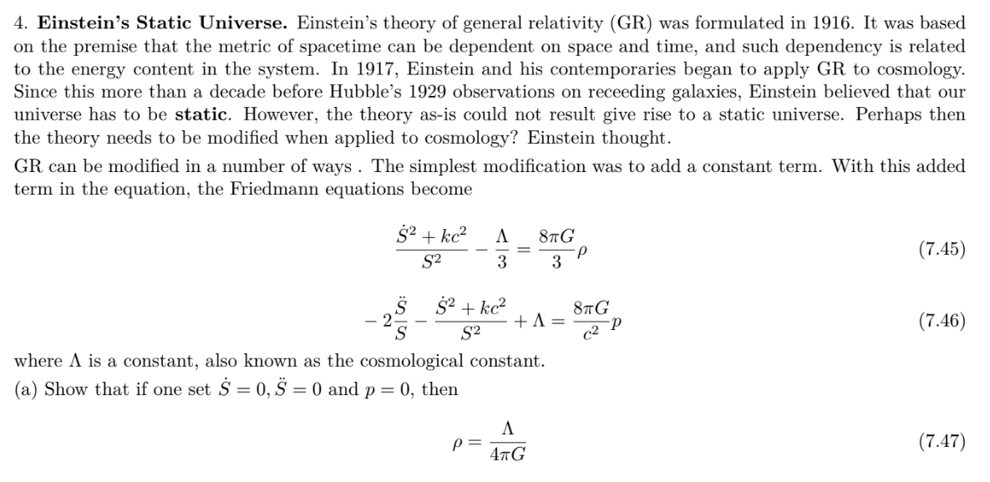
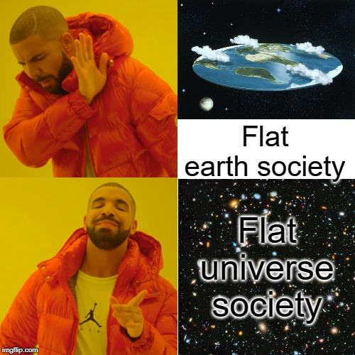


Slide 8



Slide 9




Add the two expressions,

Slide 10






Add the two expressions,

Slide 11


Slide 12

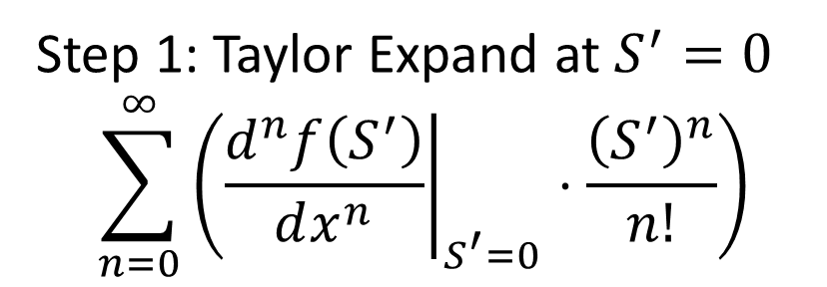




Slide 13

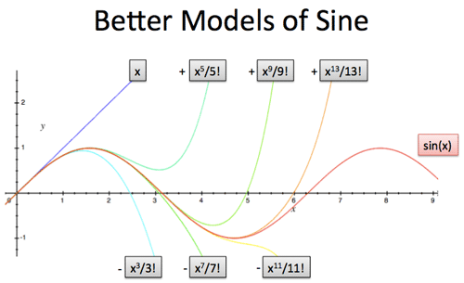
Taylor expansion

Slide 14
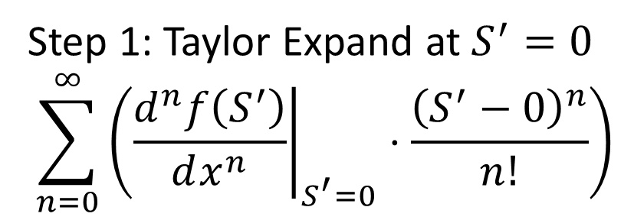





Slide 15



Slide 16

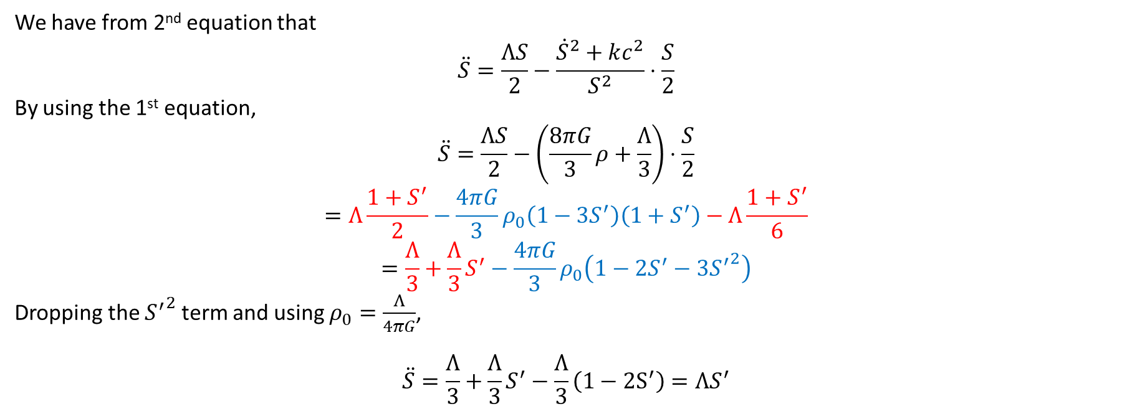

Slide 17
TRIVIAL AND LEFT AS AN
EXERCISE FOR THE READER

Slide 18

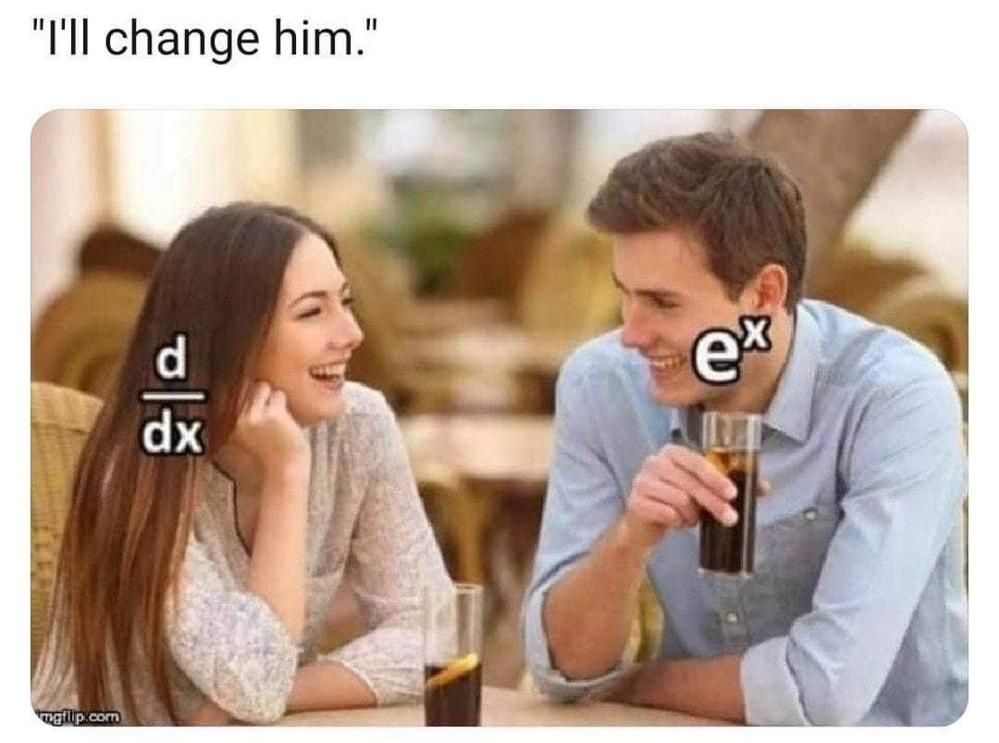

TRIVIAL AND LEFT AS AN
EXERCISE FOR THE READER

Slide 19


TRIVIAL AND LEFT AS AN
EXERCISE FOR THE READER

Slide 20

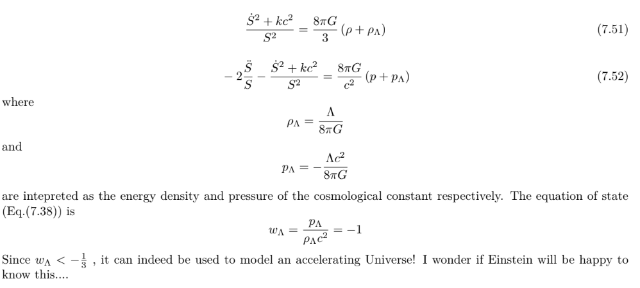

Slide 21
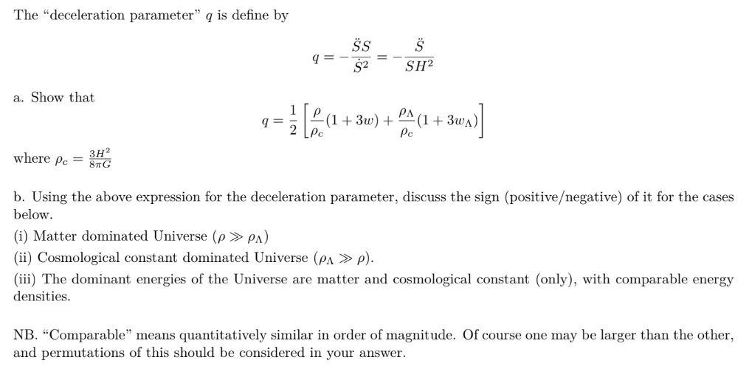
TRIVIAL AND LEFT AS AN
EXERCISE FOR THE READER
(for real this time)

Slide 22


TRIVIAL AND LEFT AS AN
EXERCISE FOR THE READER
(for real this time)

